Slide 1
CSC-257 Theory Of Computation (BSc CSIT, TU)
Ganesh Khatri
kh6ganesh@gmail.com

Slide 2
Left and Right Linear Grammars
A grammar G = (V, T, P, S) is said to be left linear grammar(LLG) if all the productions are of the form
A → Bx | x
And it is said to be right linear grammar(RLG) if all the productions are of the form
A → xB | x
where, A, B ∈ V and x ∈ T*
It means, RHS of LLG productions start with non-terminals followed by zero or more numbers of terminals and
RHS of RLG productions start with zero or more numbers of terminals followed by a non-terminal

Slide 3
Regular Grammar
A regular grammar is a CFG which may be either :
Left Linear
Right Linear
A language generated by regular grammar is called Regular Language.
A regular grammar represents a language that is accepted by some finite automata called regular language
Note : All the CFGs are note regular i.e. all the CFGs can not be converted into left linear or right linear.

Slide 4
Equivalence of Regular Grammar and Finite Automata
A right linear grammar can be converted into equivalent finite automata using the following rules :
Note : Number of states of finite automata will be one more than number of non-terminals in regular grammar and, each non-terminal represents a state in finite automata. Such one additional state is the final state.
Transitions of equivalent automata :
The start symbol of regular grammar is the start state of the finite automaton.
For every production of the form A → aB, make 𝛿(A, a) = B : make an edge labelled with ‘a’ from A to B.
For every production of the form A → a, make 𝛿(A, a) = Final state
For every production of the form A → ε, make 𝛿(A, ε) = Final state

Slide 5
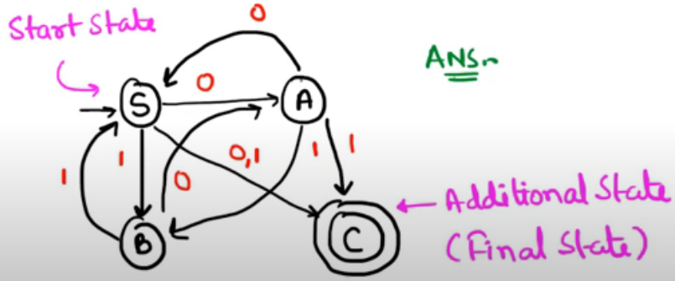
Equivalence of Regular Grammar and Finite Automata
Example : Convert the following RLG into equivalent finite automata.
S → 0A | 1B | 0 | 1
A → 0S | 1B | 1
B → 0A | 1S
Solution : Following the steps, we get the finite automata as :

Slide 6
Equivalence of Regular Grammar and Finite Automata
Exercise : Convert the following right linear grammars into finite automata
1.
S → 0S | 1A | 1
A → 0A | 1A | 0 | 1
2.
S → aaA | B | baB | ε
A → bS | aS | b

Slide 7
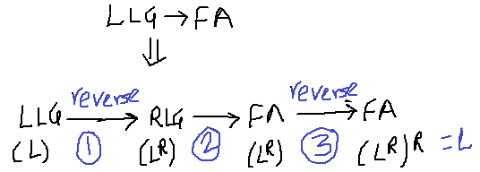
Equivalence of Regular Grammar and Finite Automata
A left linear grammar can be converted into equivalent finite automata using the following rules :
Reverse the left linear(LLG) grammar to right linear grammar(RLG). (Note : reverse the combinations of terminals and non terminals)
Convert RLG obtained in step 1 into finite automata.
Reverse finite automata obtained in step. [Note : exchange start and final states and reverse the directions of the transitions]. This will be our required finite automata for LLG.
Note : The regular grammar obtained from finite automata of step 3 will be RLG and is equivalent to original LLG.

Slide 8
Equivalence of Regular Grammar and Finite Automata
Example : Convert the following LLG into equivalent finite automata.
S → Ca | Aa | Bb
A → Ab | Ca | Bb | a
B → Bb | b
C → Aa
Solution :
Step 1 : Reversing the LLG, we get
S → aC | aA | bB
A → bA | aC | bB | a
B → bB | b
C → aA

Slide 9
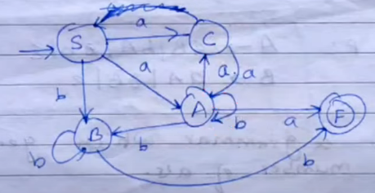
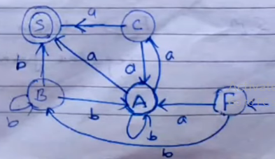
Equivalence of Regular Grammar and Finite Automata
Step 2 : Now, convert the grammar into FA, we get
Step 3 : Now, reversing the FA, we get
Now, equivalent RLG will be
F → aA | bB
A → bA | aC | a
B → bB | bA | b
C → aA | a

Slide 10
Equivalence of Regular Grammar and Finite Automata
Exercise : Convert the following left linear grammars into finite automata
1.
S → Aab
A → Aab | B
B → a

